Slide 1
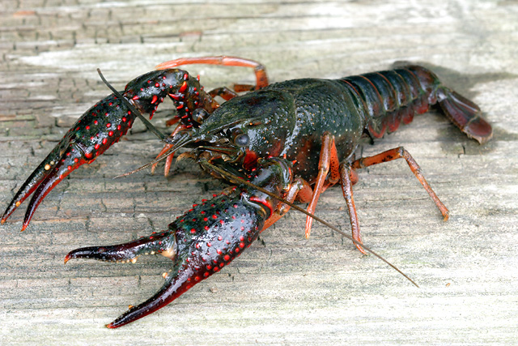
Lab 5: Investigating behavior of invasive crayfish

Slide 2
Lab roadmap
YOU ARE HERE:
Invasive species and behavior: crayfish!
Due Today
Lab 5 pre-lab
WHERE WE’RE GOING:
Into the woods Due next week
Lab 6 pre-lab In lab: field work!
Skills demos!

Slide 3
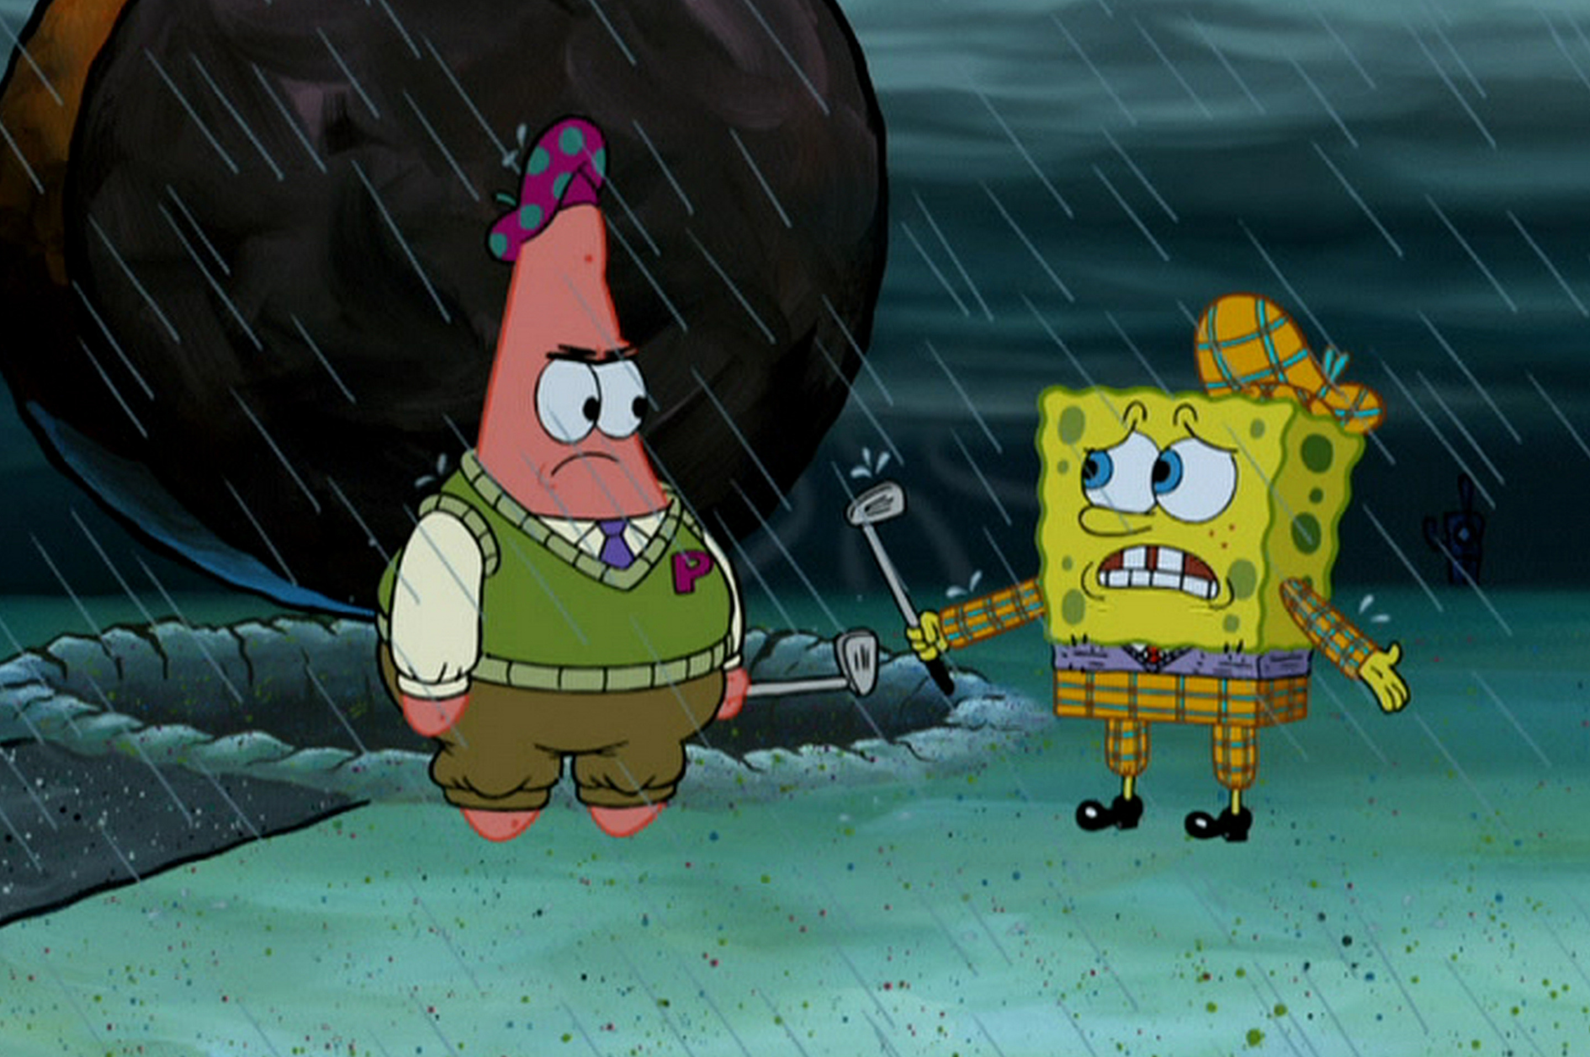
Lab roadmap
YOU ARE HERE:
Invasive species and behavior: crayfish!
Due Today
Lab 5 pre-lab
WHERE WE’RE GOING:
Into the woods Due next week
Lab 6 pre-lab In lab: field work!
DRESS APPROPRIATELY! Dress for all weather, pollen, and presence of poison oak.
Close toed shoes, long pants, sunscreen, bandanna to cover face for allergies.. etc
Skills demos! (2 per group)

Slide 4
Lab roadmap
YOU ARE HERE:
Invasive species and behavior: crayfish!
Due Today
Lab 5 pre-lab
WHERE WE’RE GOING:
Into the woods Due next week
Lab 6 pre-lab In lab: field work!
Field trip waiver: All students will need to sign a field trip waiver. If anyone is under 18, your parent will need to sign. Please let me know ASAP to coordinate.
Skills demos! (2 per group)

Slide 5
About the homework..
HYPOTHESIS
What we think will happen, and why (mechanisms). ‘because’ statement recommended
PREDICTION
What the data will look like if the hypothesis is supported. ‘if-then’ statement recommended
should include your explanatory and response variables
Notes:
I’m going to take some time to address common errors I saw in the assignments. First, reminder of what the hypothesis and prediction should contain.

Slide 6
About the homework..
Research Question:
Does false brome impact plant diversity?
Hypothesis:
The presence of false brome will be bad for plant diversity.
Can you find at least two things wrong with this hypothesis?
Missing rationale.
Doesn’t define what is meant by “be bad”.
Notes:
Now I’ll ask students what’s wrong with this hypothesis, hopefully they’ll at least identify the missing rationale. They may or may not get the other details.

Slide 7
About the homework..
Re-written hypothesis:
The presence of false brome will decrease the number of other herbaceous species present, because it is invasive.
Hard mode: now what’s wrong with it?
The rationale doesn’t explain the biological root of how it is able to outcompete the other plants.
We want to focus on mechanisms that support our claim and are related to our explanatory variable.
Notes:
Let’s dig deeper. I saw a lot of hand-wavy assumptions for rationale in the hypothesis, so I want to emphasize the rationale should be related to our explanatory variable and biological mechanisms.
I put a citation in the hypothesis to illustrate that the rationale should be supported. Although, likely it would have been discussed earlier in the text.

Slide 8
About the homework..
Re-re-written hypothesis:
The presence of false brome will decrease the number of other herbaceous species present, because its seeds outcompete the seeds of other plants for early season moisture*.
* The rationale should be supported by primary literature previously cited in a background or introduction section
Notes:
Let’s dig deeper. I saw a lot of hand-wavy assumptions for rationale in the hypothesis, so I want to emphasize the rationale should be related to our explanatory variable and biological mechanisms.
I put a citation in the hypothesis to illustrate that the rationale should be supported. Although, likely it would have been discussed earlier in the text.

Slide 9
About the homework..
Hypothesis:
The presence of false brome will decrease the number of other herbaceous species present, because its seeds outcompete the seeds of other plants for early season moisture.
Prediction:
If false brome is present, then there will be less herbaceous species.
Moving on to the prediction, what’s wrong with this one?
Doesn’t include what the data (measurable) will look like. What do we mean by less?
Repeats hypothesis
Notes:
Now let’s focus on prediction, and making sure it includes what the data will look like – and isn’t just a repetition of the hypothesis.

Slide 10
About the homework..
Hypothesis:
The presence of false brome will decrease the number of other herbaceous species present, because its seeds outcompete the seeds of other plants for early season moisture.
If your hypothesis and prediction are repetitive – there’s a good chance one of them is not quite correct.
Prediction:
If false brome is present, then there will be less herbaceous species.
Moving on to the prediction, what’s wrong with this one?
Doesn’t include what the data (measurable) will look like. What do we mean by less?
Repeats hypothesis
Notes:
Now let’s focus on prediction, and making sure it includes what the data will look like – and isn’t just a repetition of the hypothesis.

Slide 11
About the homework..
Hypothesis:
The presence of false brome will decrease the number of other herbaceous species present, because its seeds outcompete the seeds of other plants for early season moisture.
Prediction:
If false brome seeds outcompete the seeds of other herbaceous plants, then the percent coverage of false brome will be negatively correlated with the number of different herbaceous species present.
Notes:
Now let’s focus on prediction, and making sure it includes what the data will look like – and isn’t just a repetition of the hypothesis.

Slide 12
About the homework..
Explanatory (independent) v Response (dependent) variables.
The explanatory variable explains your data. It is independent of the data you measure.
It is the variable you are manipulating or the treatment you are adding.
Graphed on the x axis (there’s an x in explanatory)
The response variable occurs as a response to your explanatory variables and is dependent on the conditions of the experiment caused by the explanatory variables.
It is the data you are measuring (abundance, diversity, length, etc)
Notes:
A quick review on explanatory v response variables

Slide 13
About the homework..
Explanatory (independent) v Response (dependent) variables.
Why it can be confusing: these are determined by the nature of the experiment/study, rather than by the variable.
You could study how soil moisture impacts false brome growth by measuring false brome growth at different soil moistures.
You could study how the amount of false brome impacts soil moisture levels by putting different amounts of false brome into soil of the same moisture level and then measuring that soil moisture after some time.
Explanatory: soil moisture Response: false brome growth
Explanatory: false brome growth Response: soil moisture
Notes:
Can be confusing because it is experiment specific.

Slide 14

T tests
One Sample: Is there a difference between a group and the entire population?

Slide 15
T tests
One Sample: Is there a difference between a group and the entire population?
Usually a hypothesized value or known mean

Slide 16

T tests
One Sample: Is there a difference between a group and the entire population?
Unpaired: Is there a difference between two groups?

Slide 17


T tests
One Sample: Is there a difference between a group and the entire population?
Unpaired: Is there a difference between two groups?
Paired: Is there a difference within a group at two points in time?

Slide 18
T tests
One Sample: Is there a difference between a group and the entire population?
Unpaired: Is there a difference between two groups?
Paired: Is there a difference within a group at two points in time?

Slide 19
T tests: what’s the t (test)?
One Sample: Is there a difference between a group and the entire population?
Unpaired: Is there a difference between two groups?
Paired: Is there a difference within a group at two points in time?

Slide 20
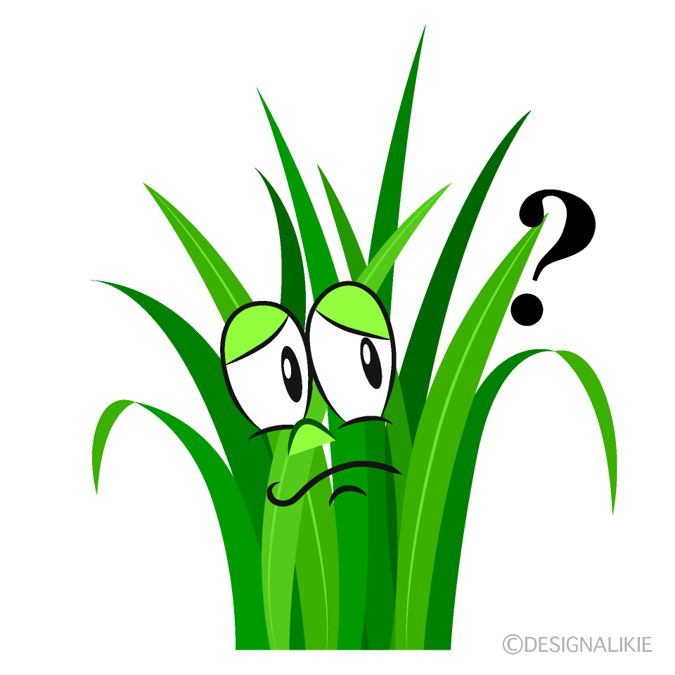


T tests: what’s the t (test)?
One Sample: Is there a difference between a group and the entire population?
Unpaired: Is there a difference between two groups?
Paired: Is there a difference within a group at two points in time?
% coverage false brome in pull zone
% coverage false brome in no-pull zone

Slide 21
T tests: what’s the t (test)?
One Sample: Is there a difference between a group and the entire population?
Unpaired: Is there a difference between two groups?
Paired: Is there a difference within a group at two points in time?
% coverage false brome in no-pull zone in 2022
% coverage false brome in no-pull zone in 2023

Slide 22

T tests: what’s the t (test)?
One Sample: Is there a difference between a group and the entire population?
Unpaired: Is there a difference between two groups?
Paired: Is there a difference within a group at two points in time?
12%
% coverage false brome in riparian zone
Total average % coverage false brome

Slide 23
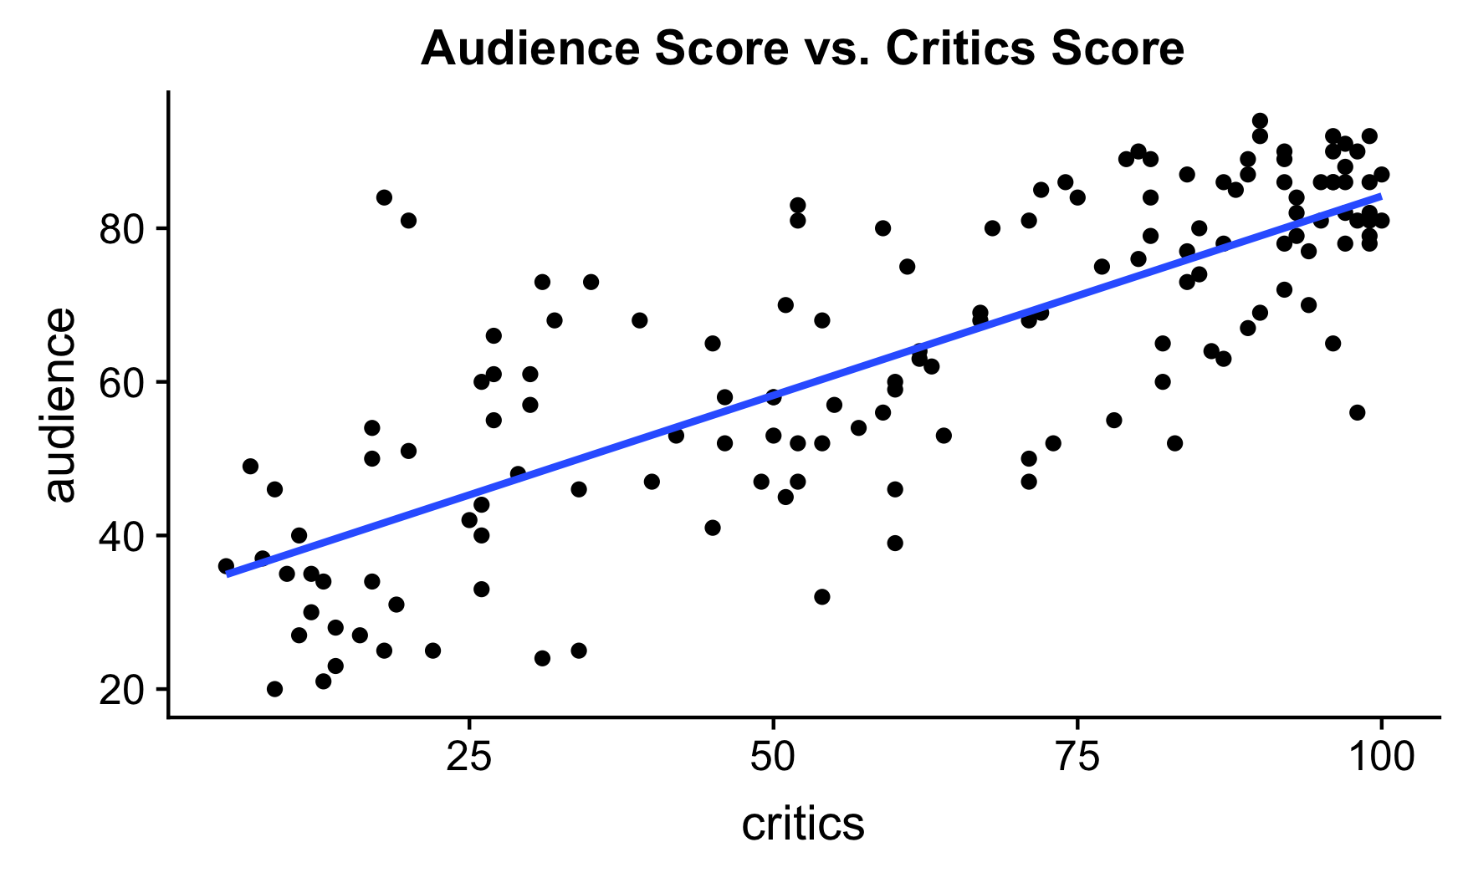
Linear Regression
Useful when comparing two quantitative variables (i.e. Distance and False Brome % Cov.)
Measures the association between independent and dependent variables
Can the ratings from movie critics be used to predict what movies the audience will like?
term | estimate | p.val
(Intercept) | 32.316 | 0.04
critics | 0.519 | 0.03
audience=32.316+0.519×critics

Slide 24
Background

Slide 25
Animal Behavior and Invasive Species
Animal behavior can be important in predicting potential invaders.
Invasive species: an organism that is not native to an ecosystem and also causes harm in that ecosystem.

Slide 26
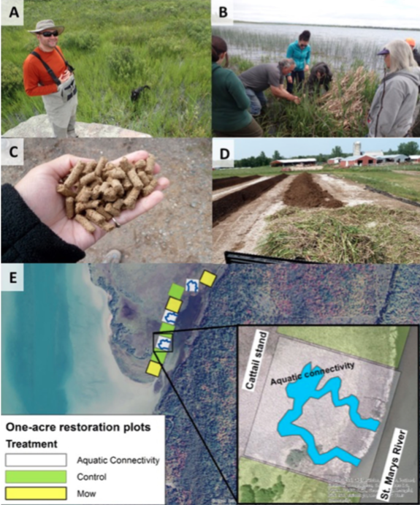
The Wide World of Science!
Anishnaabe Aki
Aki: tradition/belief held by the Anishnaabe people
For thousands of years the Anishnaabe have used cattails (Typha latifolia)
Typha angustifolia introduced from Europe, outcompetes native cattails
Anishnaabe people are working with local universities to find whether T. angustifolia has different uses and can be incorporated into traditional recipes
DOI:10.1007/s11625-018-0571-4
Notes:
Notes from slide:
Aki: tradition/belief held by the Anishnabee people
For thousands of years the Anishnaabe have used cattails (Typha latifolia)
Typha angustifolia introduced from Europe, outcompetes native cattails
Anishnaabe people are working with local universities to find whether T. angustifolia has different uses and can be incorporated into traditional recipes
Anishnaabe tradition bearers explain that invasive species are less of a threat than environmental management practices that attempt to re-engineer, command and control natural processes and places, for example via the dredging, damming and hardening of rivers
Additional notes:
Aki: the land and all living and non-living things are considered sacred, where every single being has their own special gift and has something to offer the rest of creation
According to Anishnaabe teachings, plants and animals alike assemble in nations, each with their own creation stories, kinship networks and responsibilities. The arrival of new species is to be expected and is considered by some Anishnaabe to be a form of natural migration, whether assisted by humans or not.
The Anishnaabe apply the same concept of Aki to invasive species, as well
In the image: Anishnaabe people and local universities work to find new uses for the hybrid cattails and to create appropriate areas for the cattails to grow.
More details about the image: knowledge-holders from the Bay Mills Indian Community teach Anishnaabe and non-Anishnaabe people about the uses of cattails, experimentation with pellets of hybrid cattail as an energy source, they test the nutrient value of hybrid as a fertilizer, and work to create connectivity corridors for the invasive species that mimic those created by muskrats (shaping landscape by mimicking nature instead of going against nature)
Perspectives on invasive species vary widely across different communities and even within individual indigenous communities. Respectful relationships with plant and animal nations and careful stewardship are frequent themes in indigenous environmental management, but there are often divergent opinions about whether or how to address invasive species.
Students have access to a paper about Anishnabee concept of Aki as it related to invasive species through OSU libraries: https://search.library.oregonstate.edu/permalink/f/1g9lfhc/TN_cdi_gale_infotracacademiconefile_A552980228
Sources
Reo, Nicholas J, & Ogden, Laura A. (2018). Anishnaabe Aki: an indigenous perspective on the global threat of invasive species. Sustainability Science, 13(5), 1443–1452. https://doi.org/10.1007/s11625-018-0571-4
https://www.dartmouth.edu/press-releases/seeking_new_relationships_with_invasive_species.html

Slide 27
The Wide World of Science!
Anishnaabe Aki
Anishinaabe tradition bearers explain that invasive species are less of a threat than environmental management practices that attempt to re-engineer, command and control natural processes and places, for example via the dredging, damming and hardening of rivers
DOI:10.1007/s11625-018-0571-4
Notes:
Notes from slide:
Aki: tradition/belief held by the Anishnabee people
For thousands of years the Anishnaabe have used cattails (Typha latifolia)
Typha angustifolia introduced from Europe, outcompetes native cattails
Anishnaabe people are working with local universities to find whether T. angustifolia has different uses and can be incorporated into traditional recipes
Anishnaabe tradition bearers explain that invasive species are less of a threat than environmental management practices that attempt to re-engineer, command and control natural processes and places, for example via the dredging, damming and hardening of rivers
Additional notes:
Aki: the land and all living and non-living things are considered sacred, where every single being has their own special gift and has something to offer the rest of creation
According to Anishnaabe teachings, plants and animals alike assemble in nations, each with their own creation stories, kinship networks and responsibilities. The arrival of new species is to be expected and is considered by some Anishnaabe to be a form of natural migration, whether assisted by humans or not.
The Anishnaabe apply the same concept of Aki to invasive species, as well
In the image: Anishnaabe people and local universities work to find new uses for the hybrid cattails and to create appropriate areas for the cattails to grow.
More details about the image: knowledge-holders from the Bay Mills Indian Community teach Anishnaabe and non-Anishnaabe people about the uses of cattails, experimentation with pellets of hybrid cattail as an energy source, they test the nutrient value of hybrid as a fertilizer, and work to create connectivity corridors for the invasive species that mimic those created by muskrats (shaping landscape by mimicking nature instead of going against nature)
Perspectives on invasive species vary widely across different communities and even within individual indigenous communities. Respectful relationships with plant and animal nations and careful stewardship are frequent themes in indigenous environmental management, but there are often divergent opinions about whether or how to address invasive species.
Students have access to a paper about Anishnabee concept of Aki as it related to invasive species through OSU libraries: https://search.library.oregonstate.edu/permalink/f/1g9lfhc/TN_cdi_gale_infotracacademiconefile_A552980228
Sources
Reo, Nicholas J, & Ogden, Laura A. (2018). Anishnaabe Aki: an indigenous perspective on the global threat of invasive species. Sustainability Science, 13(5), 1443–1452. https://doi.org/10.1007/s11625-018-0571-4
https://www.dartmouth.edu/press-releases/seeking_new_relationships_with_invasive_species.html

Slide 28
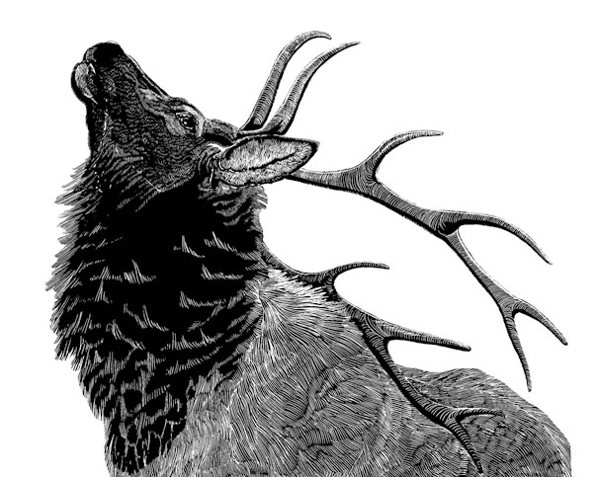
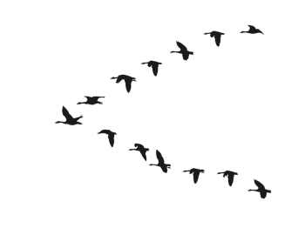
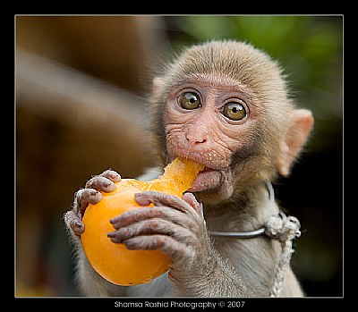
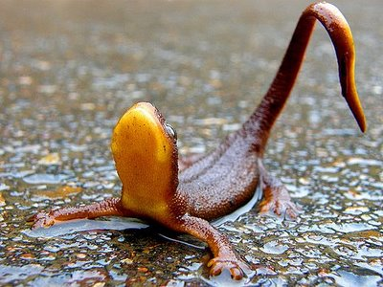
What IS Behavior?!
Notes:
how should we define it? What counts as behavior?
Hard to define, but your book defines behavior as a physiological response to an external stimuli

Slide 29
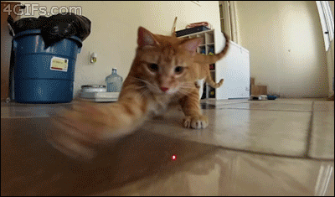
What IS Behavior?!
Hard to define but is generally a response to external stimuli
Notes:
how should we define it? What counts as behavior?
Hard to define, but your book defines behavior as a physiological response to an external stimuli

Slide 30
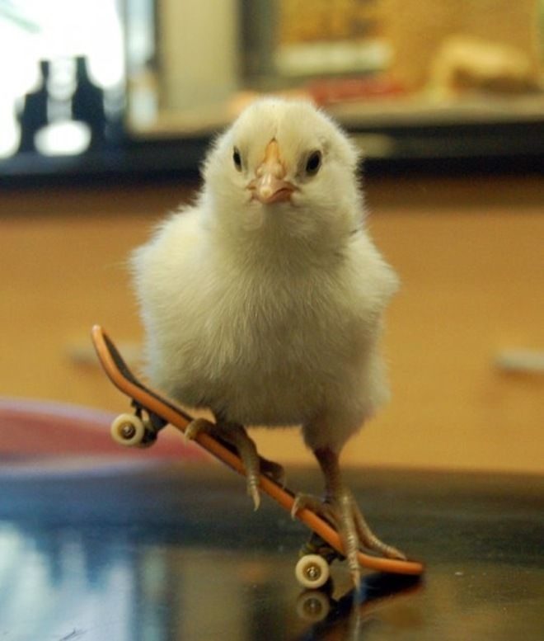
Behavioral Ecology
Study of the ecological and evolutionary basis for behavior.
Behavioral studies can help us better understand interactions
Within species (Intraspecific)
Between species (Interspecific)
Studies of invasive species can help us predict the spread or damage of a new invader.

Slide 31
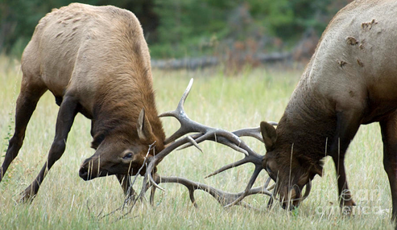
Behavior and Invasion
Agonistic Behavior - Aggressive behavior between members of the same or different species.
A large part of invasive species’ impact on ecosystem where they are introduced.

Slide 32
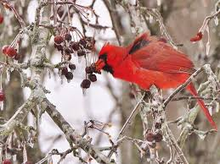
Behavior and Invasion
Foraging Behavior - Any behavior used to find food.
Unknown how invasive species foraging behaviors contribute to their persistence in new environments and competition with natives

Slide 33
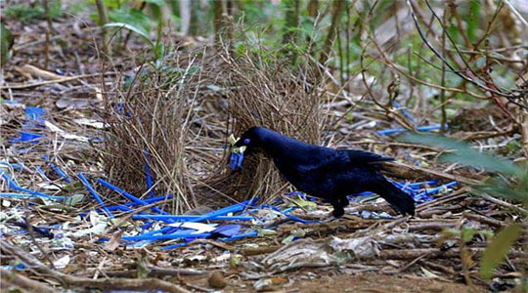
Behavior and Invasion
Reproductive Behavior – Any behavior used to attract mates
Invasive species reproduce rapidly in novel environments.
Why? This is different for every species.
Much of it may have to do with a lack of natural predators.

Slide 34
Tinbergen’s 4 Questions
Single form
Historical series
Causation How does it work? | Development How did it develop?
Function Why do they do it? | Evolution Why did it evolve?
Proximate
Ultimate

Slide 35
Tinbergen’s 4 Questions
Single form
Historical series
Causation What stimulus led to this behavior? | Development How did it develop?
Function Why do they do it? | Evolution Why did it evolve?
Proximate
Ultimate

Slide 36
Tinbergen’s 4 Questions
Single form
Historical series
Causation How does it work? | Development How does it develop in an individual?
Function Why do they do it? | Evolution Why did it evolve?
Proximate
Ultimate

Slide 37
Tinbergen’s 4 Questions
Single form
Historical series
Causation How does it work? | Development How did it develop?
Function Why is a behavior useful? | Evolution Why did it evolve?
Proximate
Ultimate

Slide 38
Tinbergen’s 4 Questions
Single form
Historical series
Causation How does it work? | Development How did it develop?
Function Why do they do it? | Evolution Why and how did a behavior evolve?
Proximate
Ultimate

Slide 39
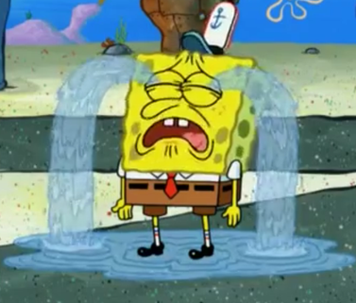
why do babies cry?
Single form
Historical series
Causation pain, discomfort, hunger,.. | Development Develops via cognitive maturation
Function Elicits caregiving, conveys information | Evolution Enforce parental care, increases survivorship
Proximate
Ultimate

Slide 40
why do babies cry?
Single form
Historical series
Causation pain, discomfort, hunger,.. | Development Develops via cognitive maturation
Function Elicits caregiving, conveys information | Evolution Enforce parental care, increases survivorship
Proximate
Ultimate

Slide 41
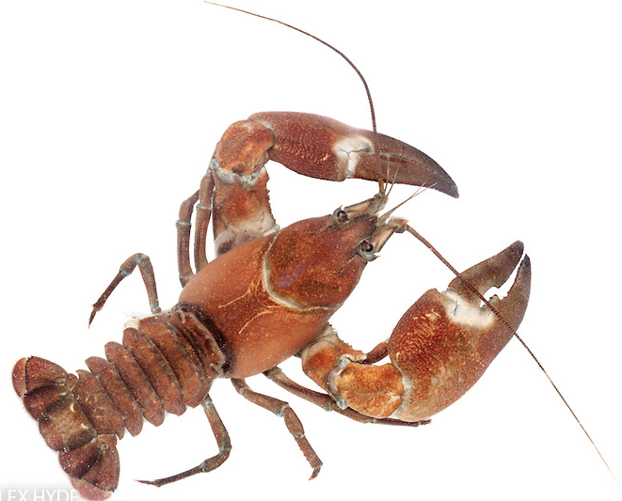
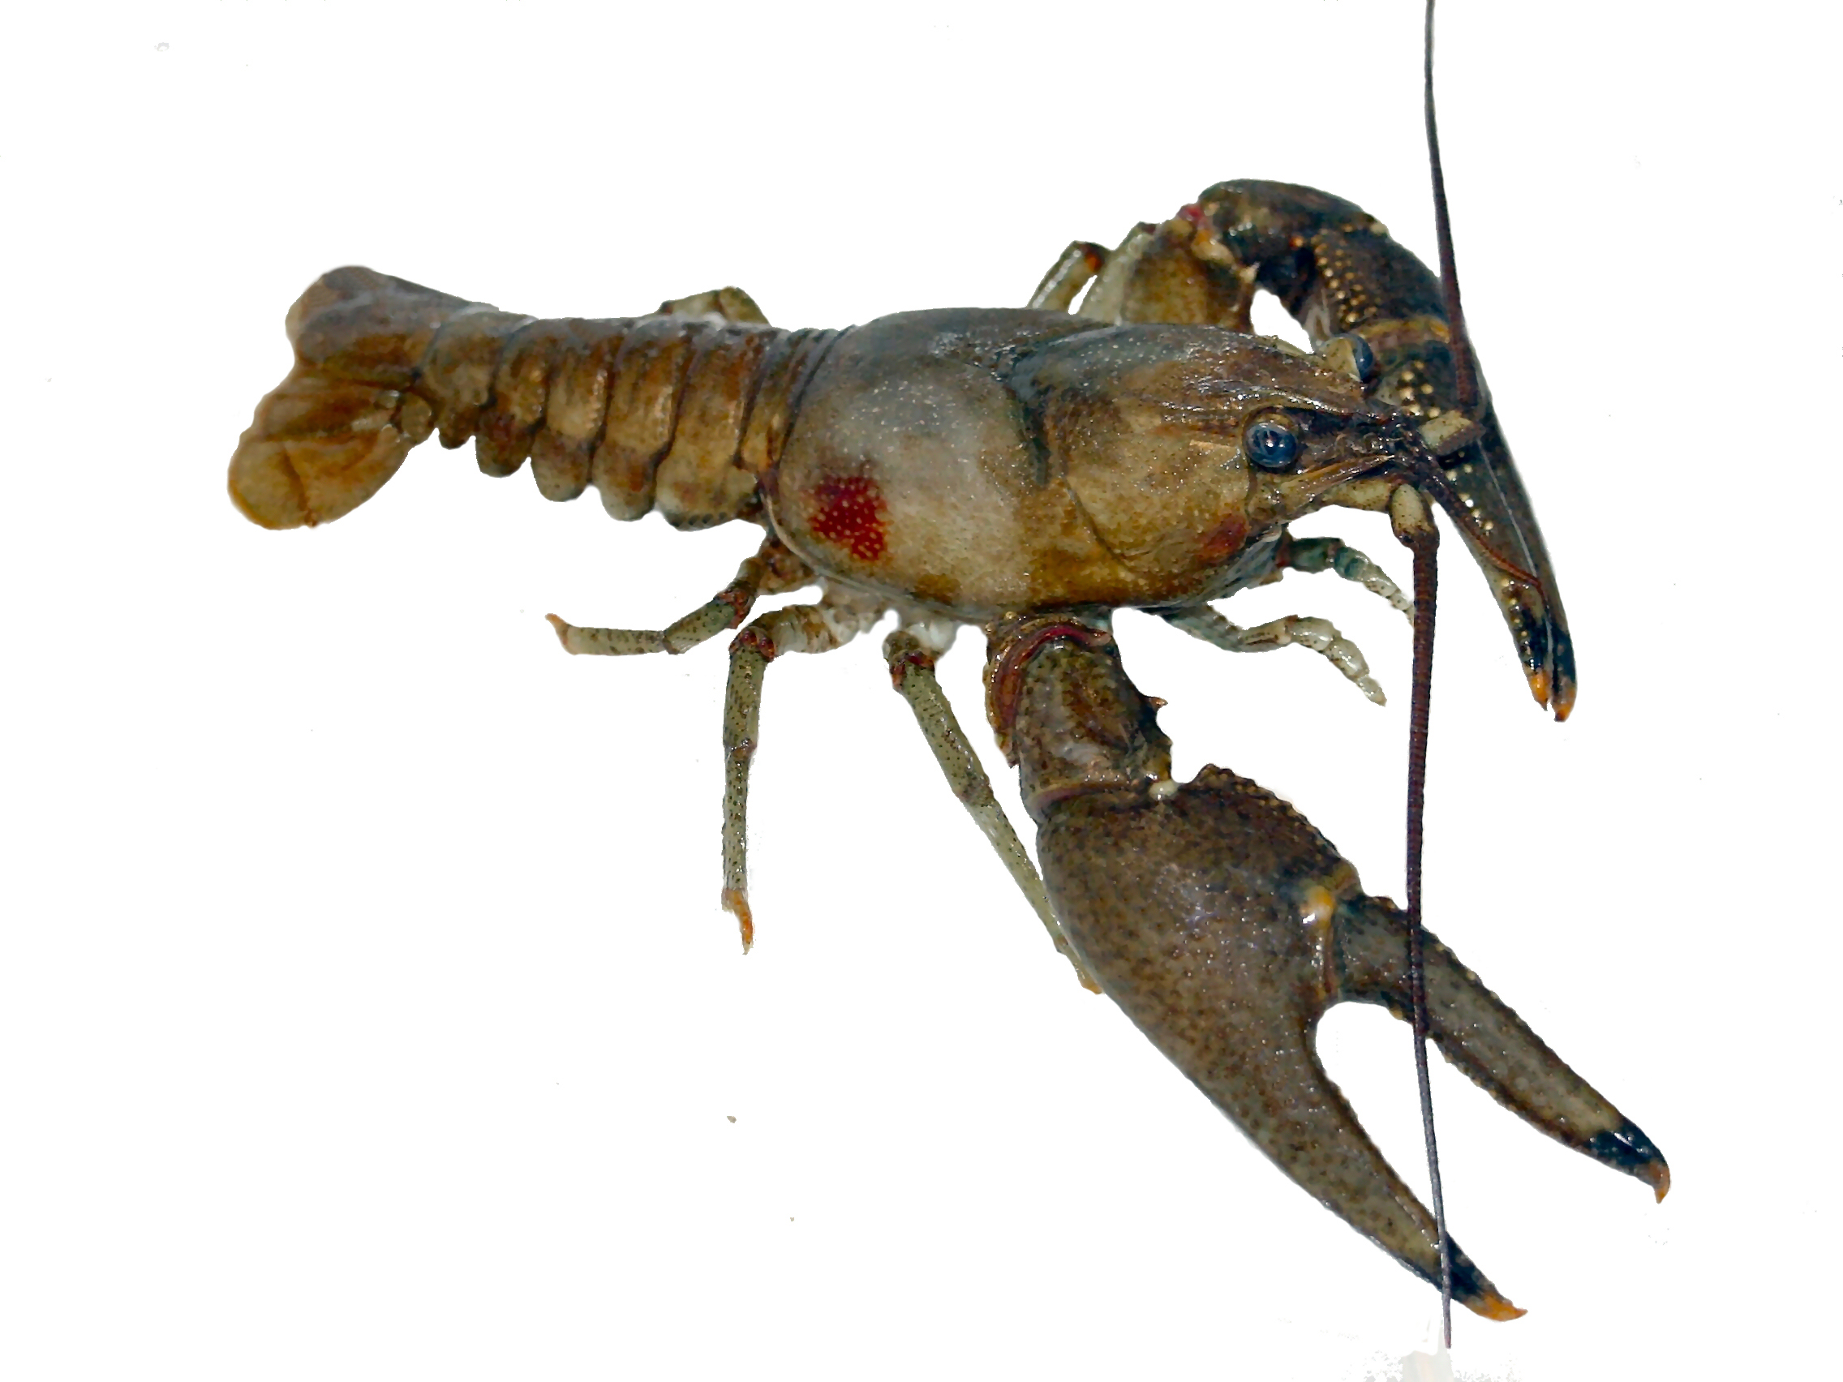
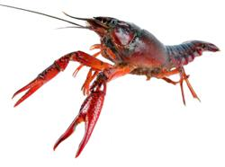
Today we will be investigating behavior in crayfish and how that might affect invasion success.
Notes:
The crayfish to the left is the native signal

Slide 42
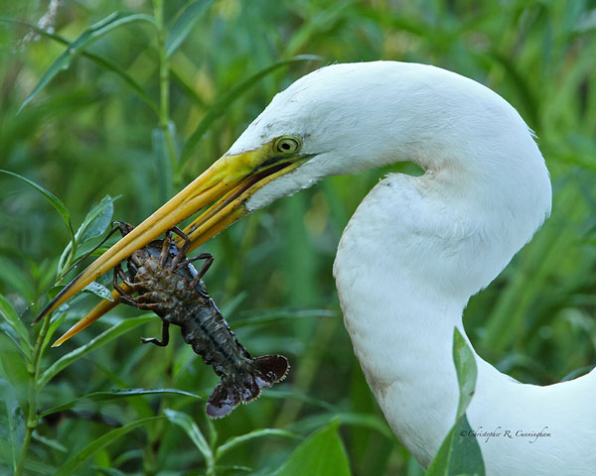
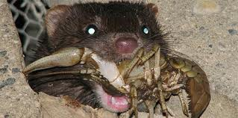
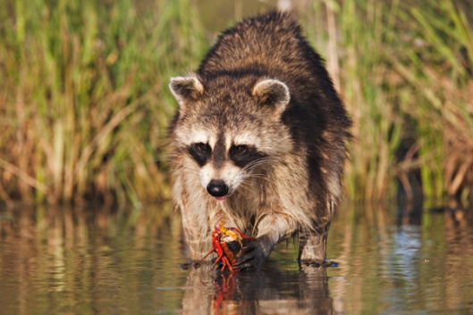
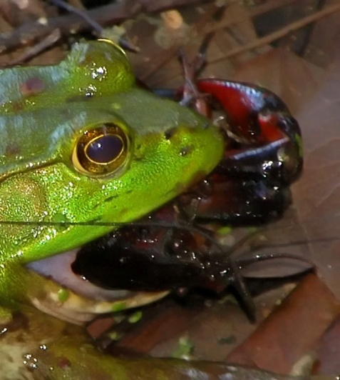
Why Crayfish?
Organism that affects many trophic levels: they eat and get eaten by many other organisms.
Diet is varied - eat aquatic plants, amphibian larvae, small fish, aquatic invertebrates, and dead animals.
Crayfish are food source for birds, fish, snakes, amphibians, mammals, and even other crayfish.

Slide 43
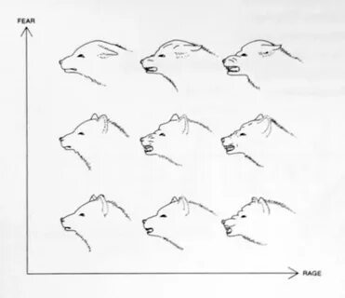
The challenge
Turning qualitative observations of behavior into quantitative measurements
We’ll use an ethogram

Slide 44
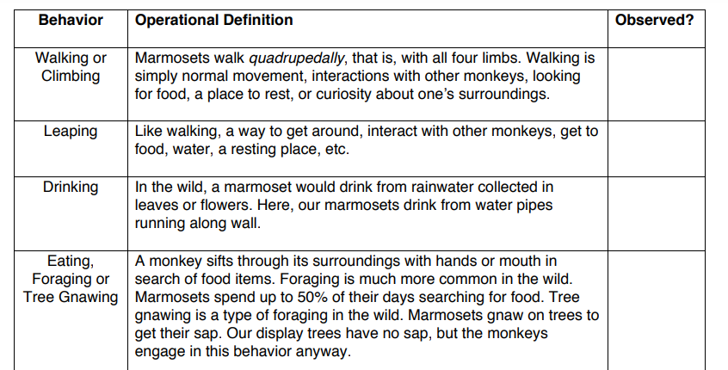
Turning behavior into data: Ethogram
An ethogram is a catalogue or inventory of behaviors
Defined behaviors should not overlap
Defined behaviors should be limited to those which help answer your research questions

Slide 45
Turning behavior into data: sampling method
Data can be taken continuously over the entire observation period, or discretely at set intervals.

Slide 46



Turning behavior into data: sampling method
Data can be taken continuously over the entire observation period, or discretely at set intervals.
You can take focal data from one individual at a time or scan data from multiple individuals at a time.

Slide 47
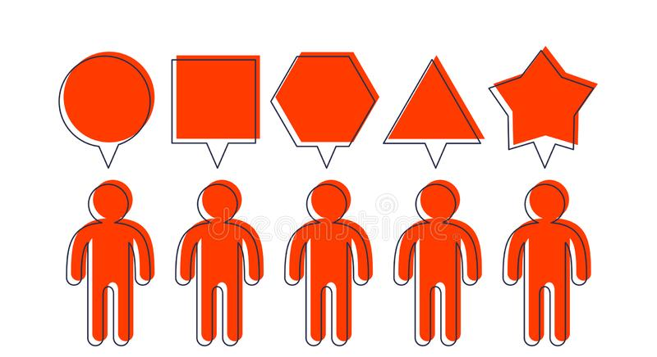
Turning behavior into data: sampling method
Data can be taken continuously over the entire observation period, or discretely at set intervals.
You can take focal data from one individual at a time or scan data from multiple individuals at a time.
Inter-observer variation can be a problem in behavior analysis.

Slide 48

Questions?

Slide 49
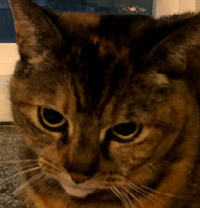
Today’s Activities

Slide 50
Part 1: Invasive species discussion
Notes:
https://media.oregonstate.edu/media/t/0_ltlermct

Slide 51
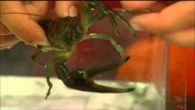
Notes:
https://media.oregonstate.edu/media/t/0_ltlermct

Slide 52
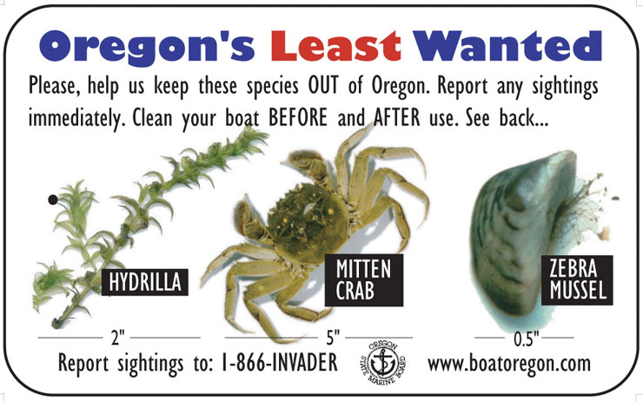
Discussion: Part 1 of lab
Should we stop spending so much money on trying to control invasive species? Why/Why not?
What would the societal ramifications be if we stopped?
Notes:
Let them discuss for about 5 min. or less if they get quiet. Call on pairs to share some ideas and write ideas on the chalkboard. Try to get them to come up with some evolution ideas like that certain species evolved together over huge lengths of time. It will take a long time for nature to balance itself out – possibly not until after we’re gone. They should come up with some of the values of biodiversity.
Societal ramifications would be losses to fisheries or other economic impacts that could affect quality of life for many individuals. Loss of tourism or ecotourism in areas that draw people in to look at wildlife. Poor water quality or damage to human infrastructures (ie zebra mussels).

Slide 53
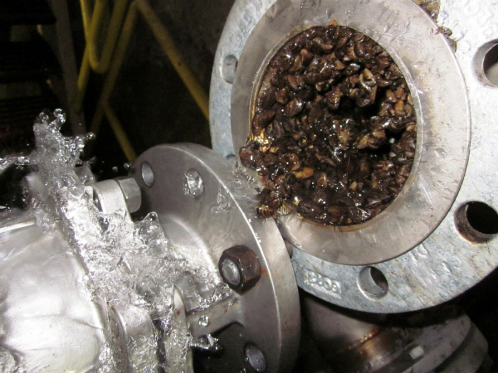
Class Discussion
What would the societal ramifications be if we stopped?
Losses to fisheries or other economic impacts
Loss of tourism or ecotourism in areas that draw people in to look at wildlife
Poor water quality or damage to infrastructure
Image: pipe clogged with zebra mussels
Notes:
Let them discuss for about 5 min. or less if they get quiet. Call on pairs to share some ideas and write ideas on the chalkboard. Try to get them to come up with some evolution ideas like that certain species evolved together over huge lengths of time. It will take a long time for nature to balance itself out – possibly not until after we’re gone. They should come up with some of the values of biodiversity.
Societal ramifications would be losses to fisheries or other economic impacts that could affect quality of life for many individuals. Loss of tourism or ecotourism in areas that draw people in to look at wildlife. Poor water quality or damage to human infrastructures (ie zebra mussels).

Slide 54
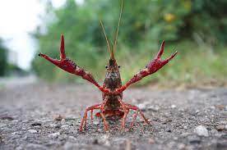
Part 2: Investigating Agonistic Behaviors of Crayfish
You will be recording agonistic behaviors using an ethogram during 10-minute contests between two crayfish
Working with another group, run 3 trials using 6 crayfish in one-on-one interactions

Slide 55
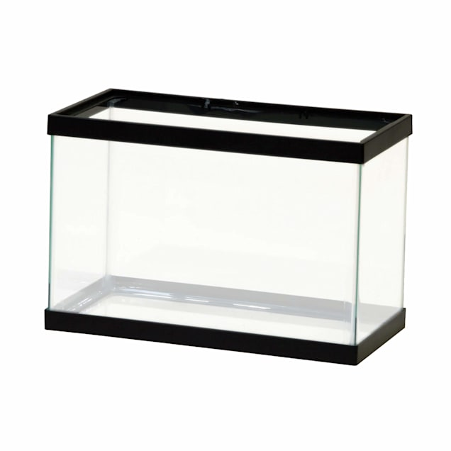
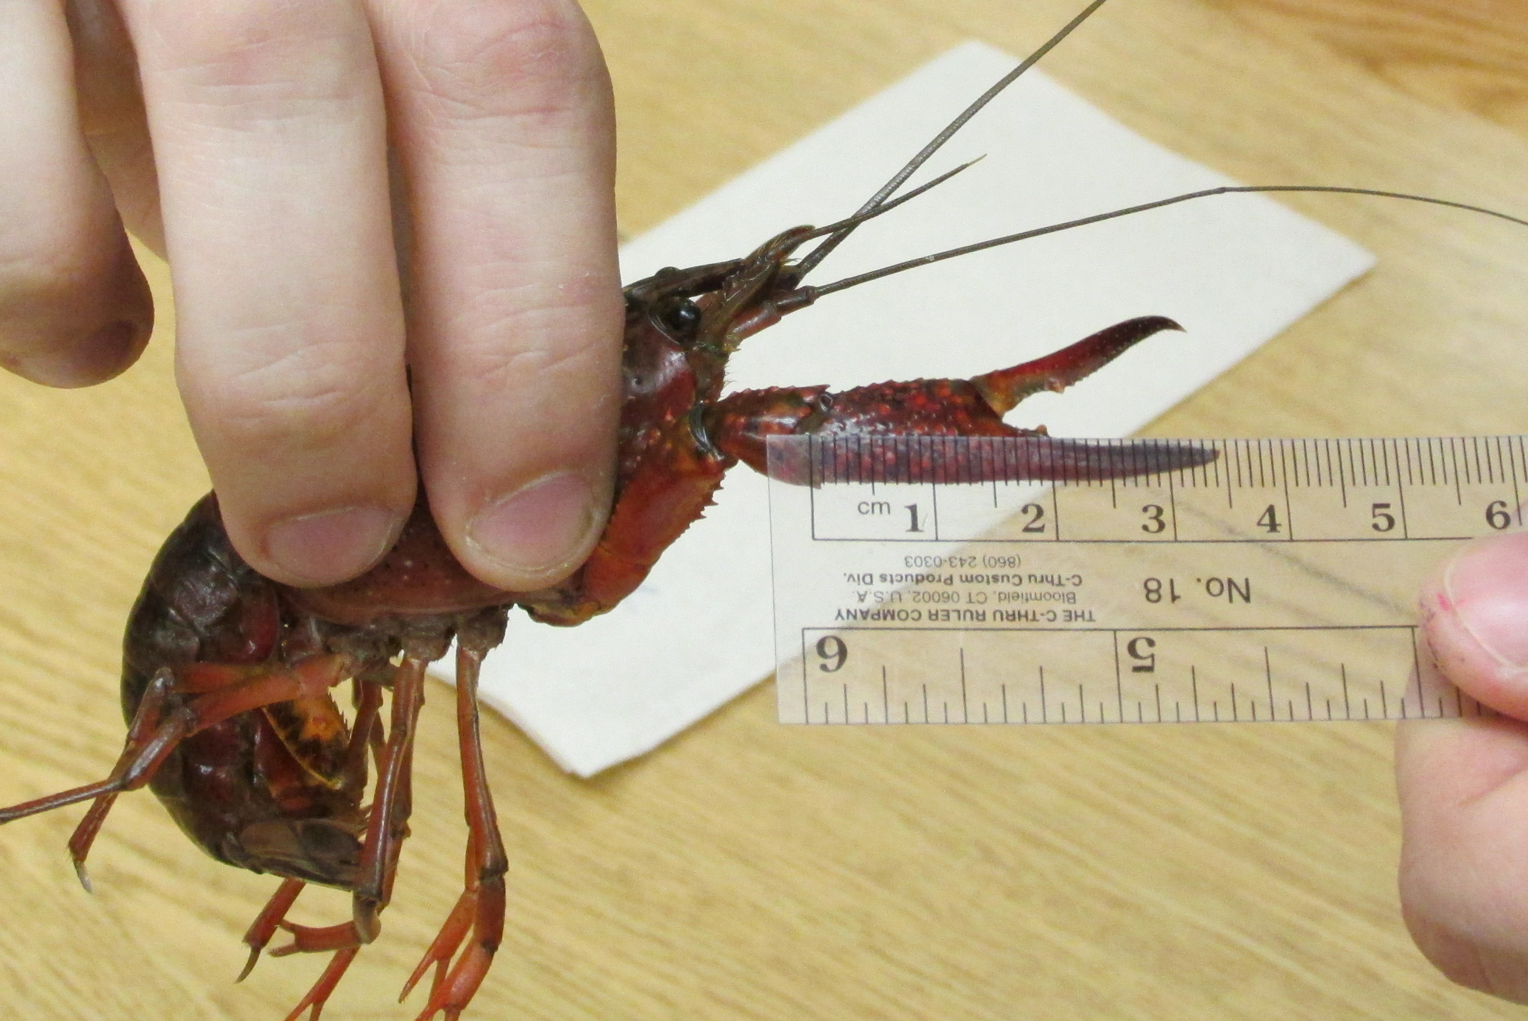
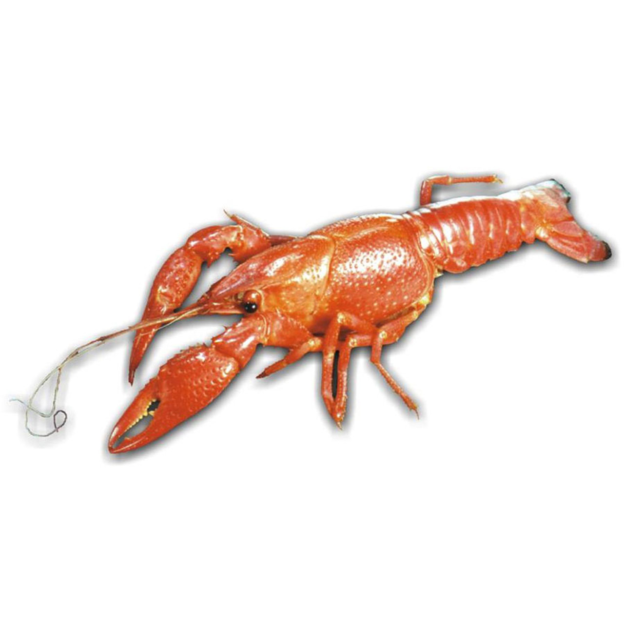
Part 2 and 3: Investigating Agonistic Behaviors of Crayfish
Measure sex, weight, and claw length of two crayfish
WAIT 4 minutes (or until first agonistic behavior) then record number of each behavior observed
Release them simultaneously on opposite ends of the tank.

Slide 56
Part 2: Investigating Agonistic Behaviors of Crayfish
Crayfish will remember each other, so we need to keep a record of the pairs that are introduced so that we don’t ruin the experiment for future labs.
Crayfish will respond to you! Try to be quiet when near the arena.

Slide 57
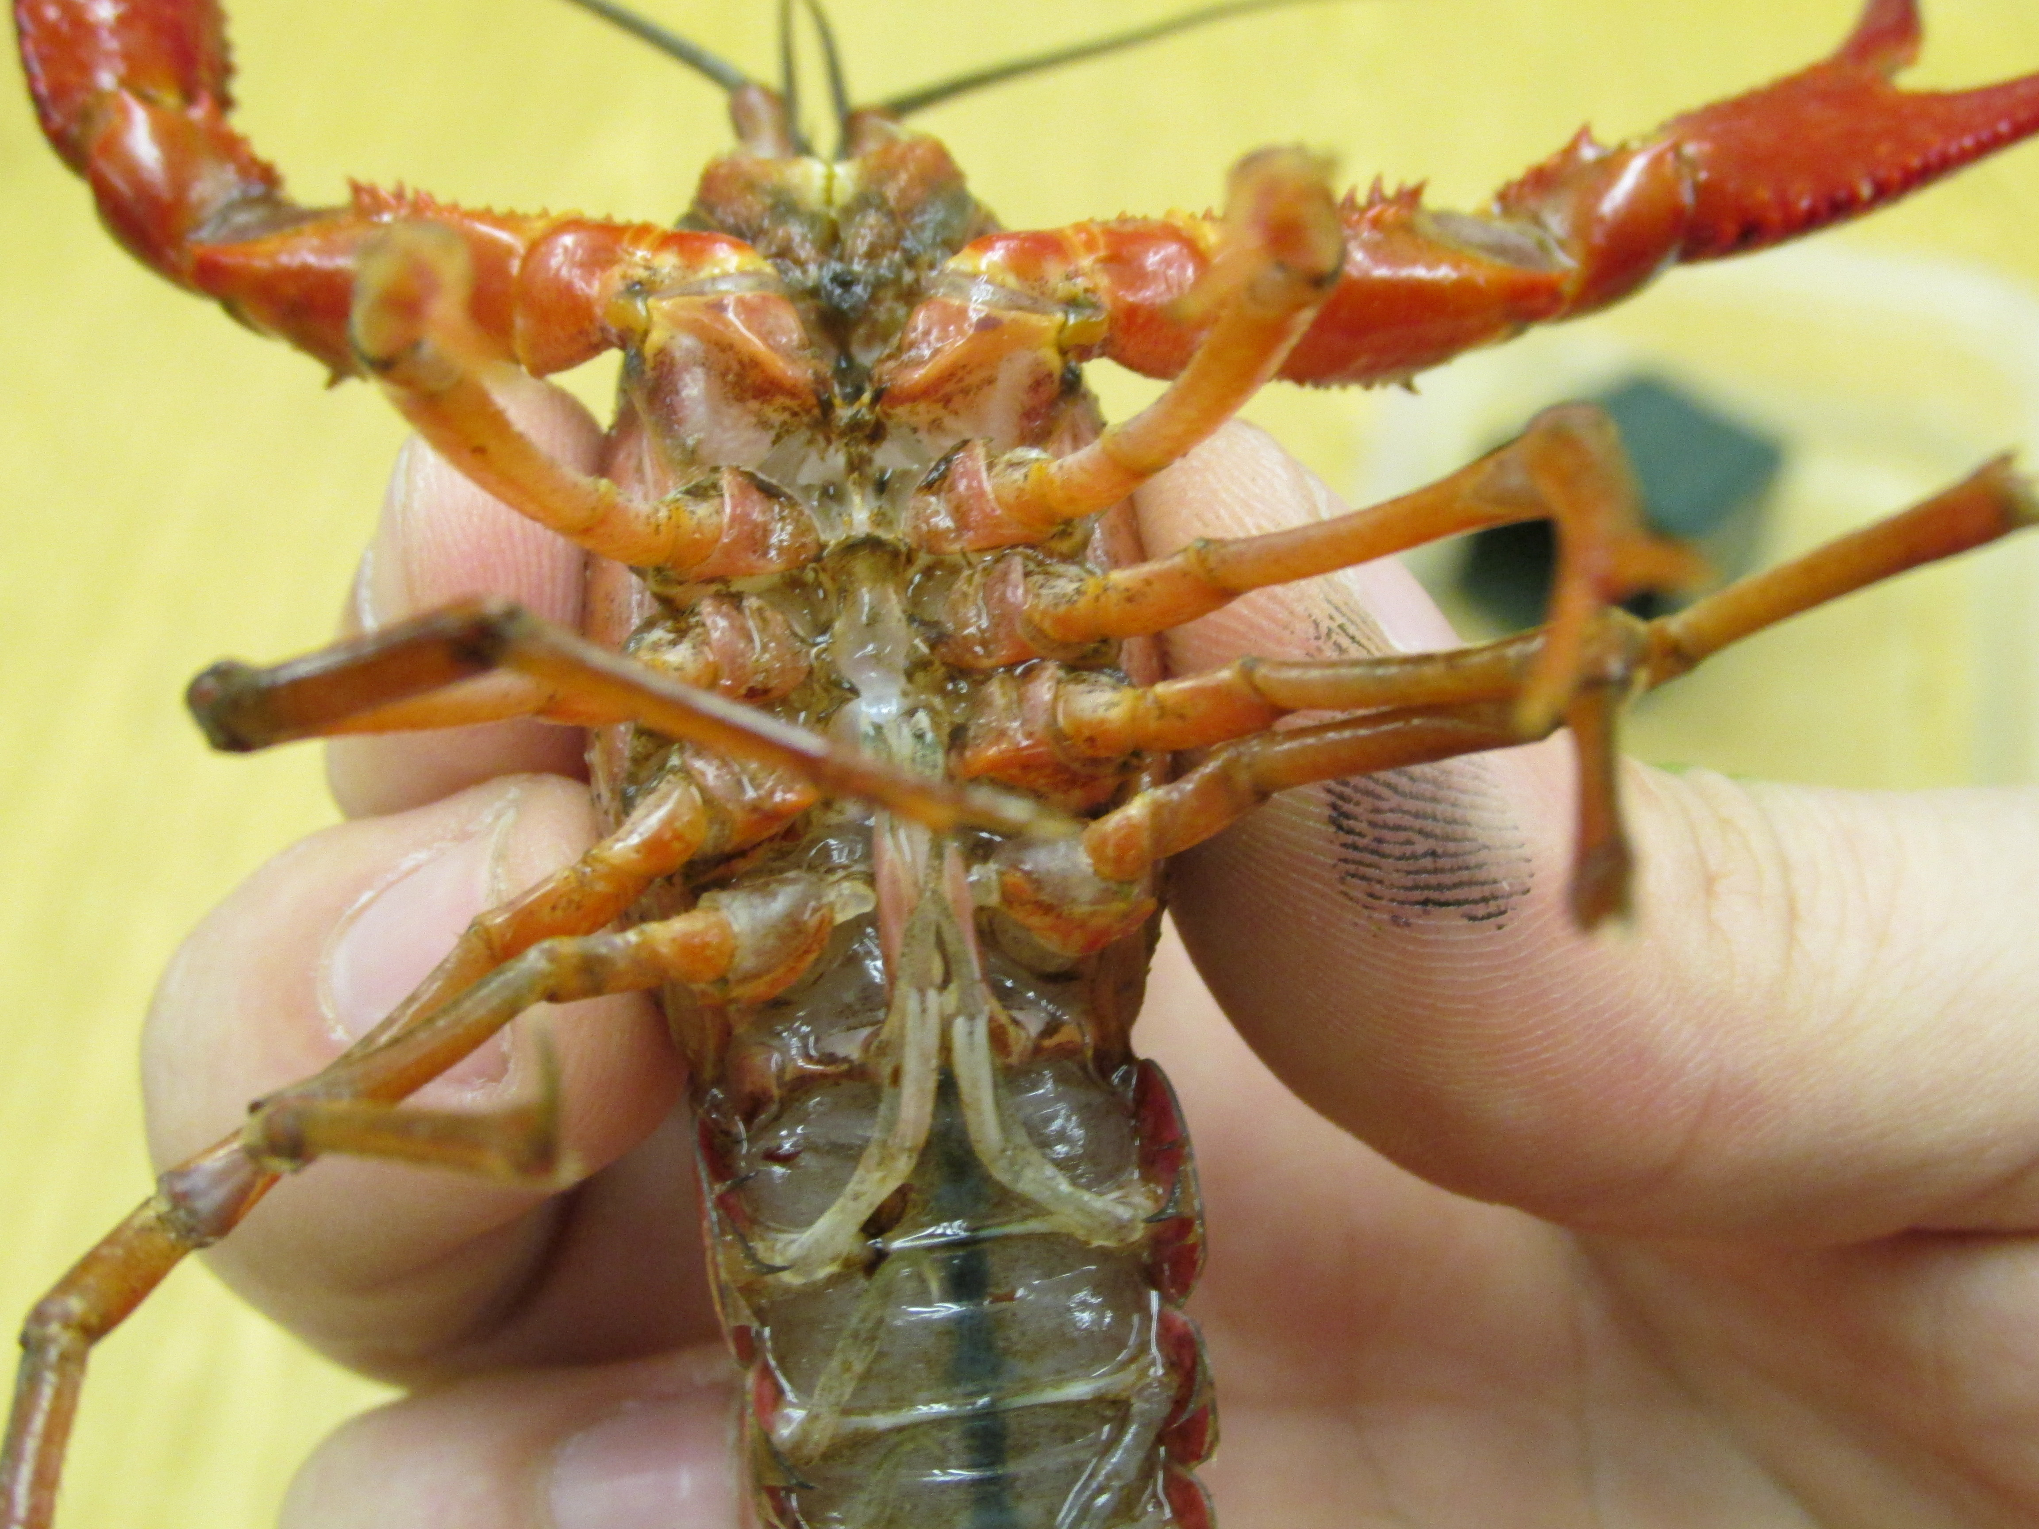
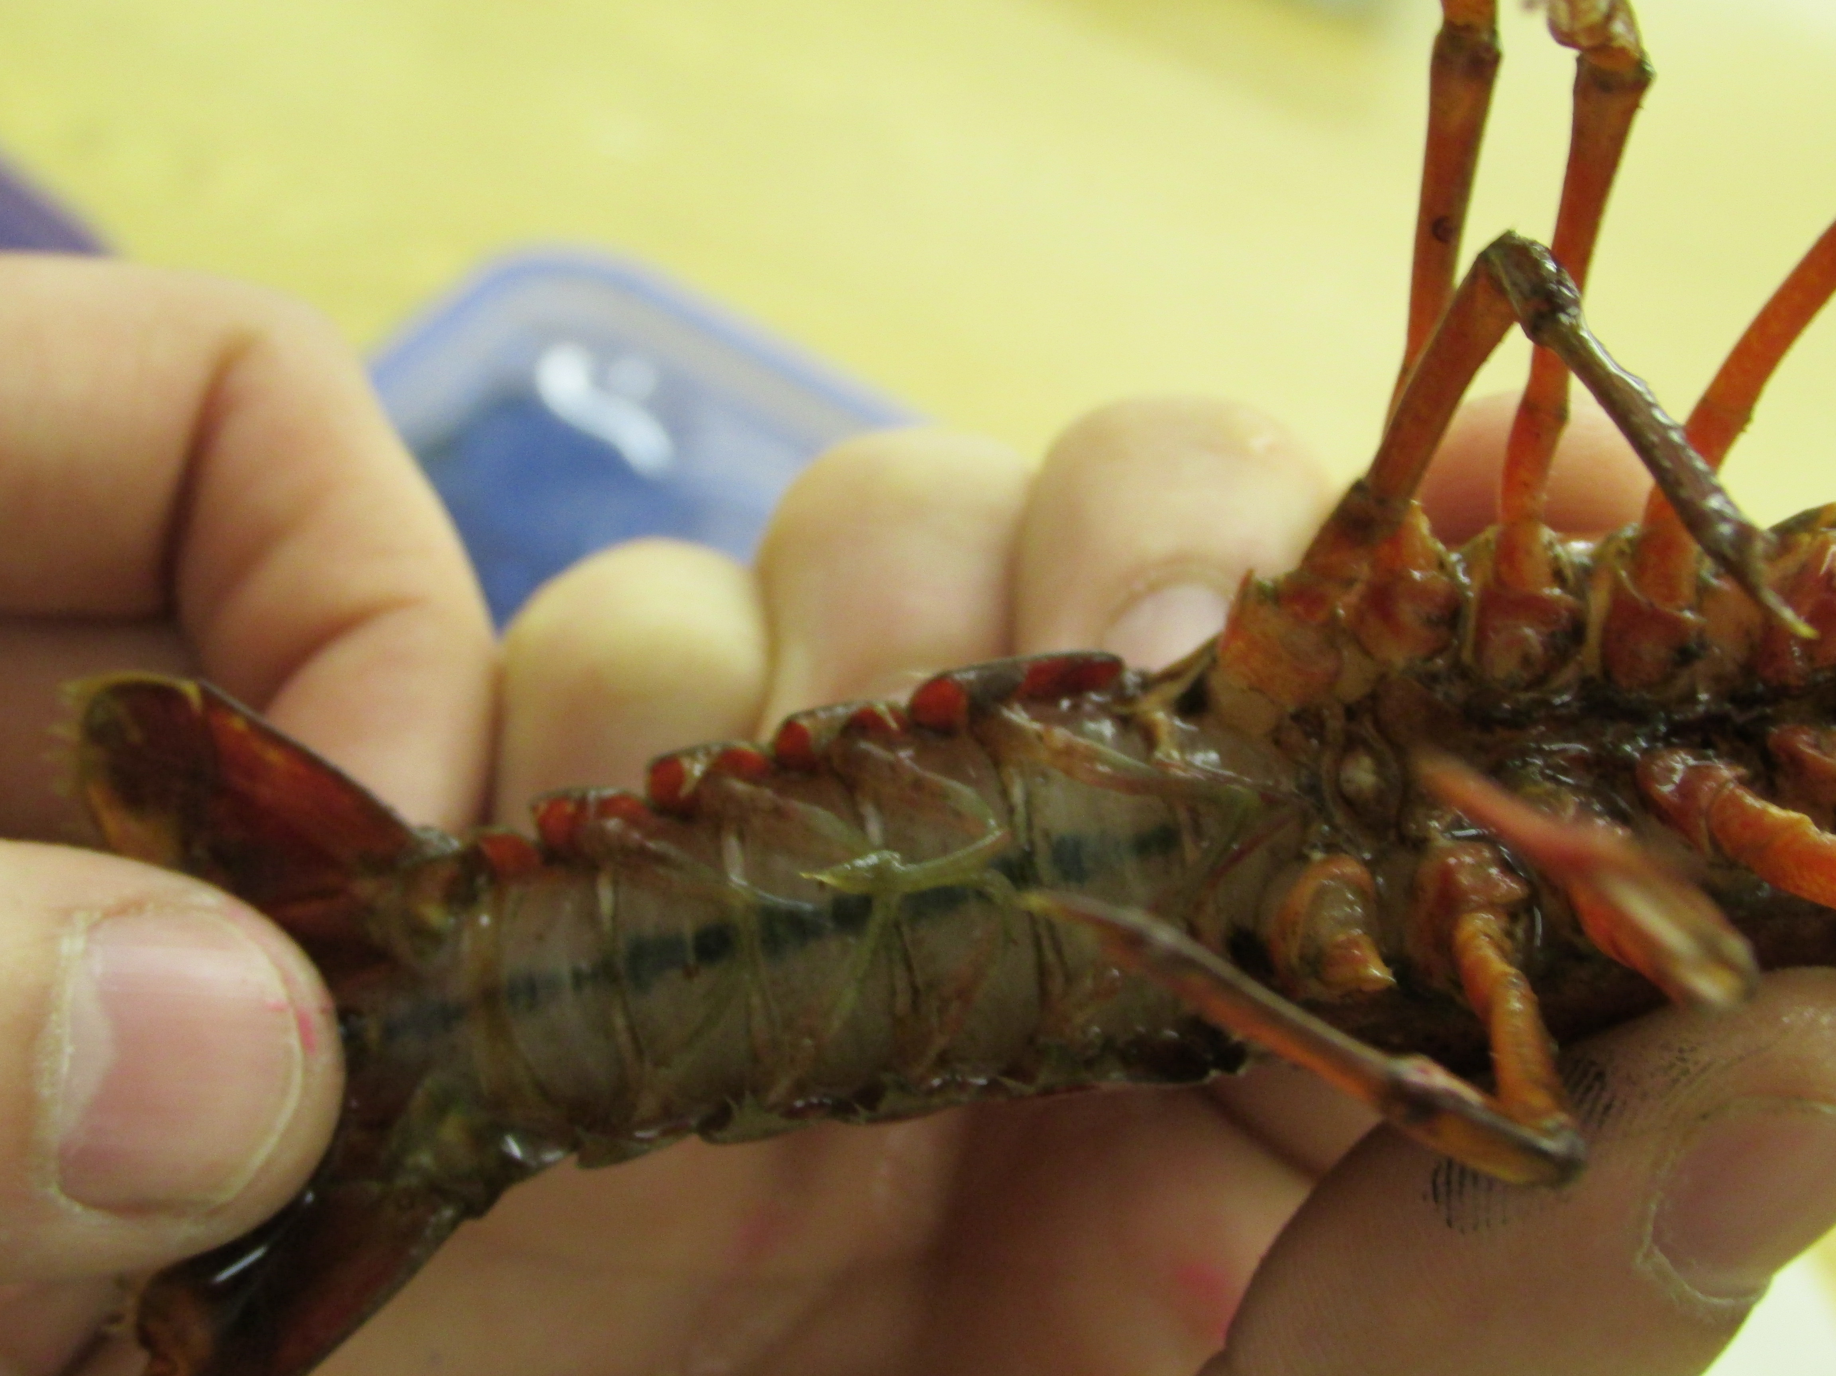
Crayfish Demo
Males have four calcified swimmerets Just below lowest legs
Females lack the calcified swimmerets
Notes:
Show them how to pick up the crayfish and point out supplies and how to collect their data. The crayfish will not fight if they are spooked by humans (they’ll try to fight you instead of the other crayfish).

Slide 58
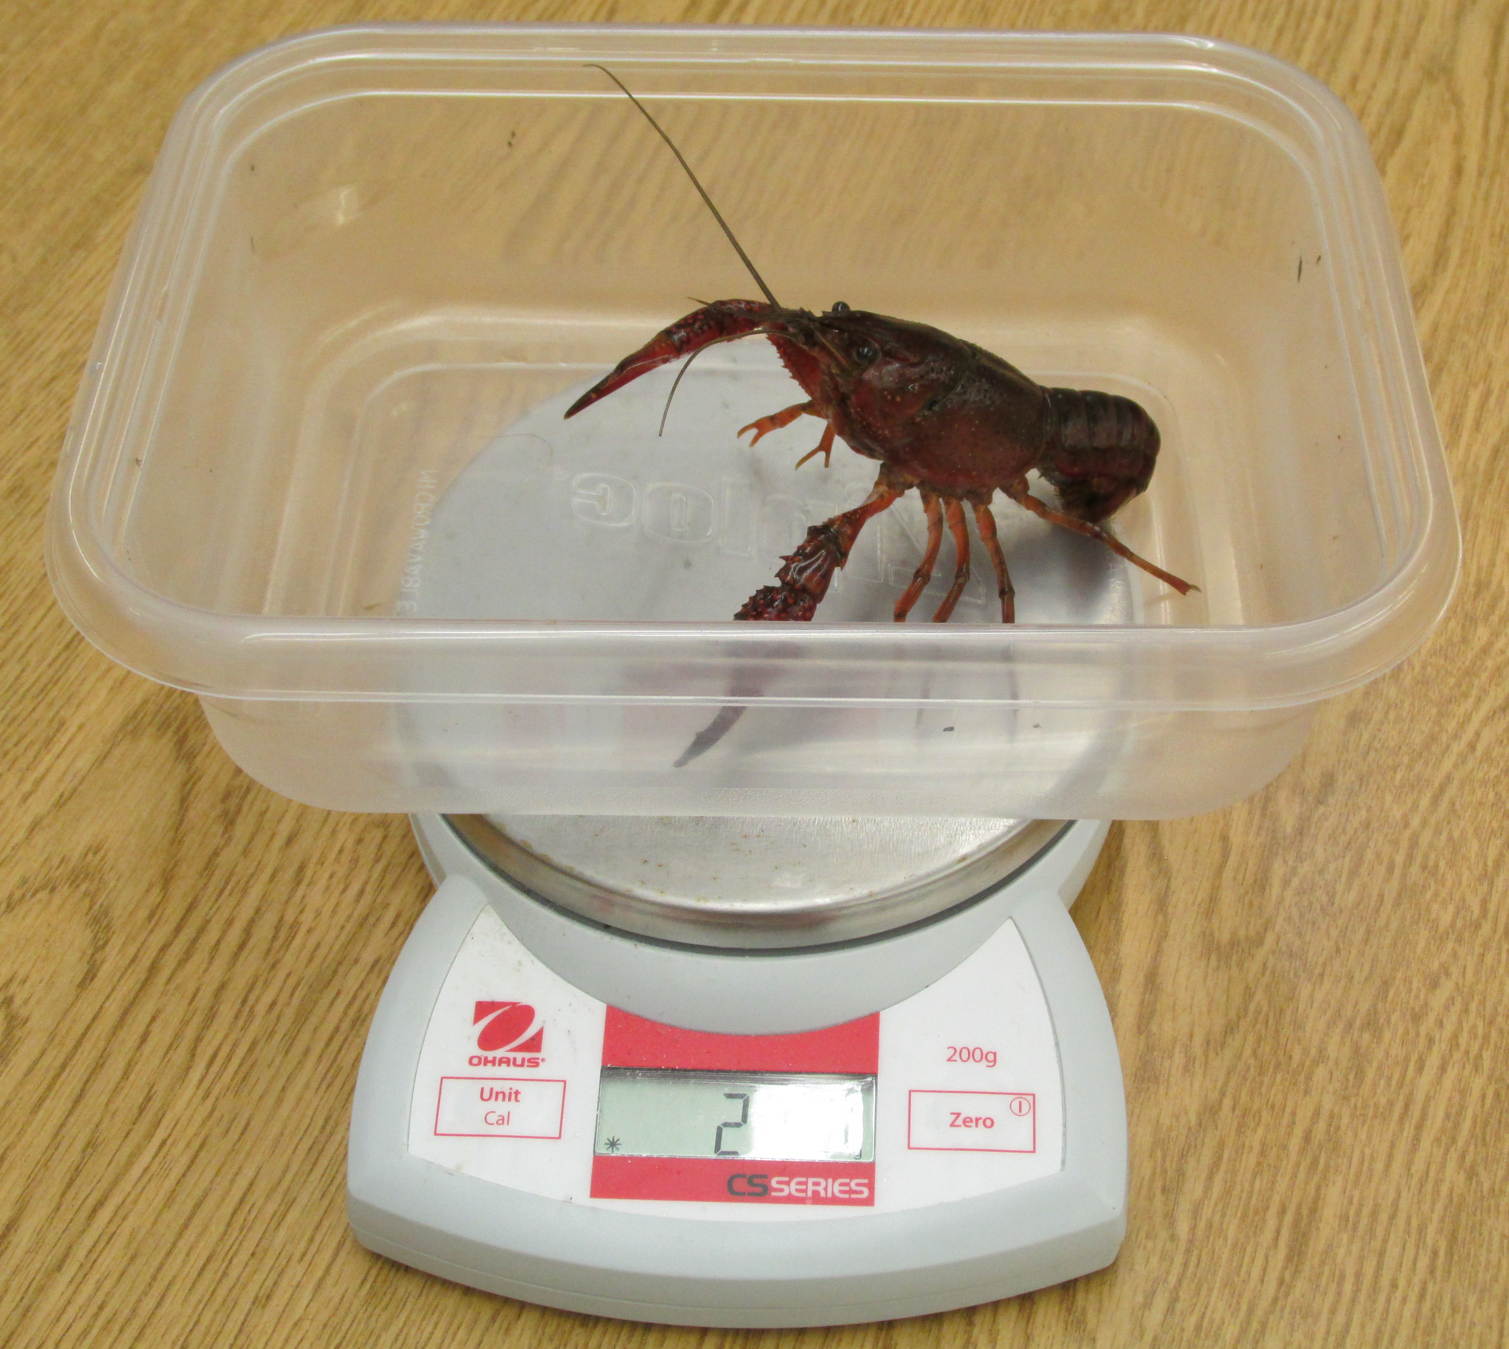
Crayfish Demo
Measure the length of the outer side of the claw
Zero scale with container in place, then place crayfish in container and record mass to 0.0 g
Notes:
Show them how to pick up the crayfish and point out supplies and how to collect their data. The crayfish will not fight if they are spooked by humans (they’ll try to fight you instead of the other crayfish).

Slide 59
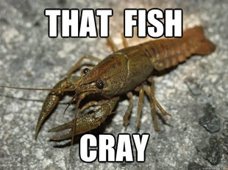
A Note About Respect
You are dealing with live organisms – be respectful
Please handle crayfish as gently as possible – or be prepared to be PINCHED
If any crayfish appears to have recently molted or might be injured – let a TA know! We should let those ones rest.

Slide 60
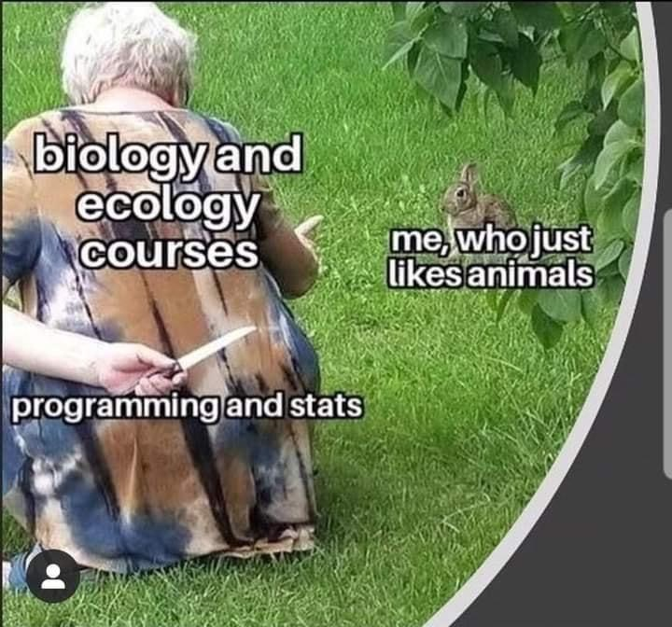
Part 3: Data Analysis
We will combine class data and perform a t-test to test your hypothesis
Null hypothesis: No difference between what we observed and expect. The trait of interest has no impact on win success.

Slide 61
Part 4: Foraging and Reproductive Behaviors
Answer some questions relating behavior and reproductive strategies to competition.
Part 5: Invasive species in society
Develop a plan for responsible handling of invasive species.

Slide 62
Questions?

Slide 63
Today’s roadmap and tips:
Part 2: invasive species behaviors
Keep a record of crayfish that are paired by filling out the matrix!
Color refers to the paint marking, not the organism
Give the crayfish a 4-minute adjustment period before gathering data.
Part 3: Data analysis
Use class data for the analysis. If the class data is not complete, move on to parts 4 and 5 while waiting for other groups to wrap up.
The number of male v female trials will be less than the total class number of trials. Add the # of male and female winners to get total.
“Trait A⁻¹” means “trait opposite of A”
To leave
2 skills demos from each group.
Clean: crayfish returned to contains. Clean water from tables with paper towels

